Slide 1
Loops & Conditionals
remainders, loops, range, conditionals

Slide 2
remainder

Slide 3
%

Slide 4
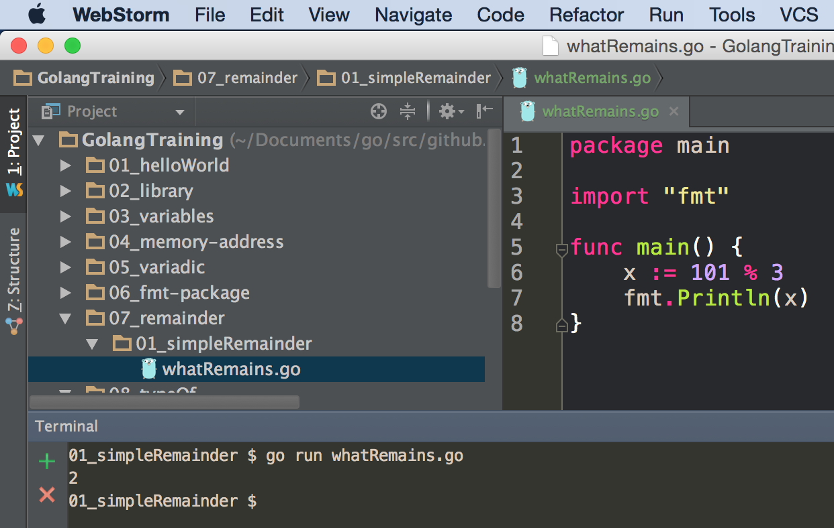

Slide 5
exercise
write a program
that allows the user to enter two numbers
then displays the remainder
when one number is divided by the other

Slide 6
loops

Slide 7
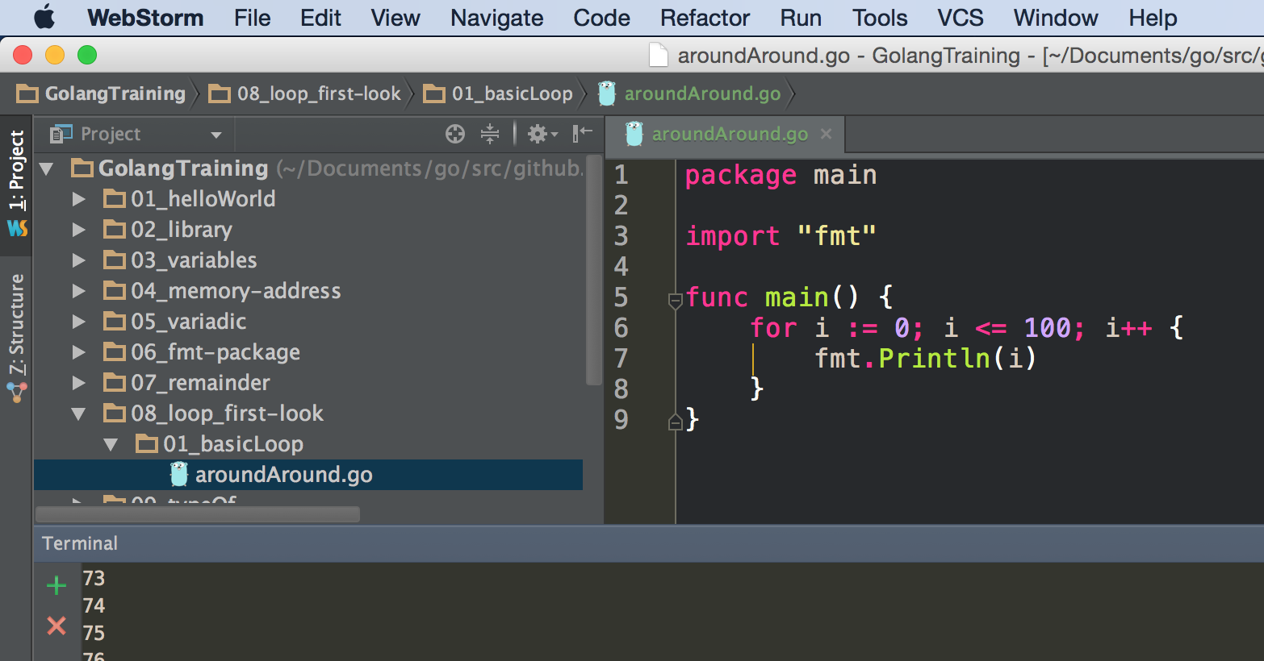

Slide 8
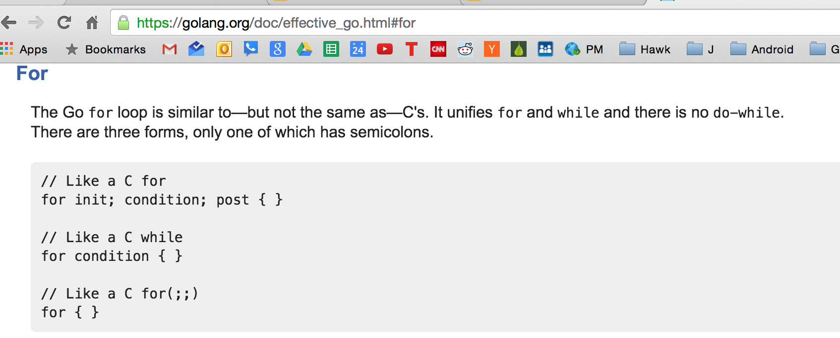

Slide 9
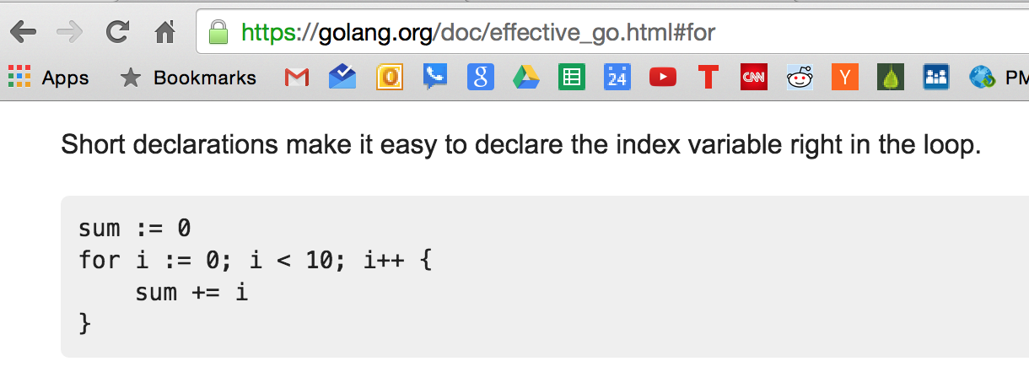
the scope of i will only be this loop

Slide 10
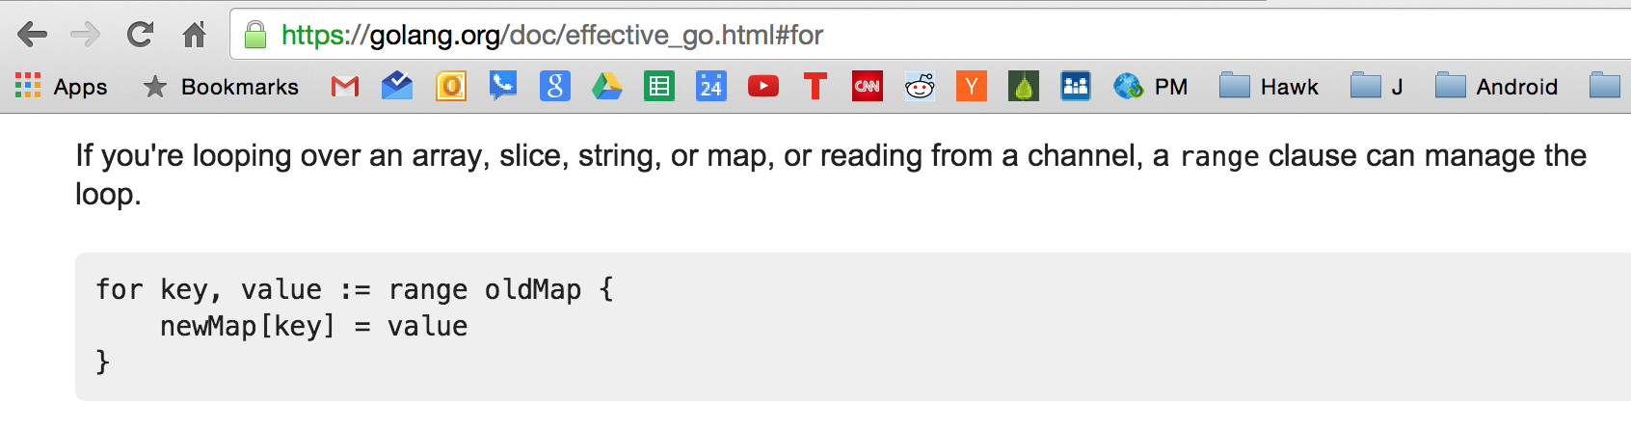
range works on these types:
slice or array
string
gives us a rune (code point to UTF-8 character)
map
key:value
channel
a channel is a way to communicate between threads (different go routines)
you can use the "for range" to read off of a channel continuously

Slide 11
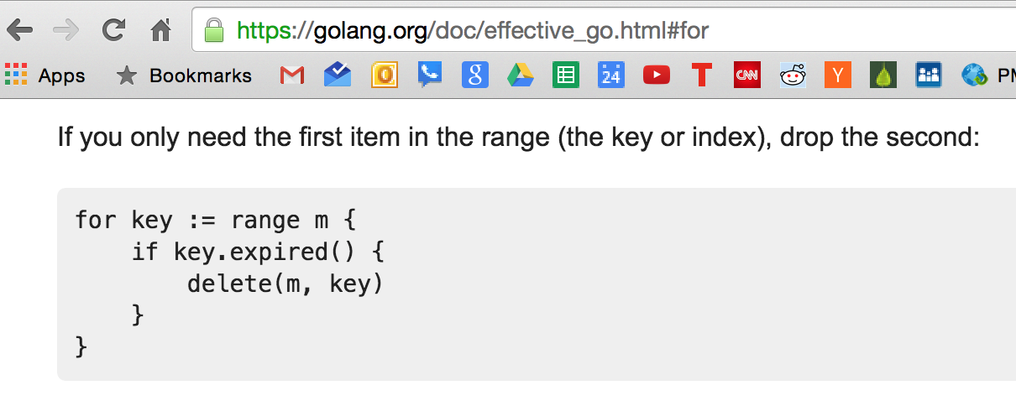

Slide 12
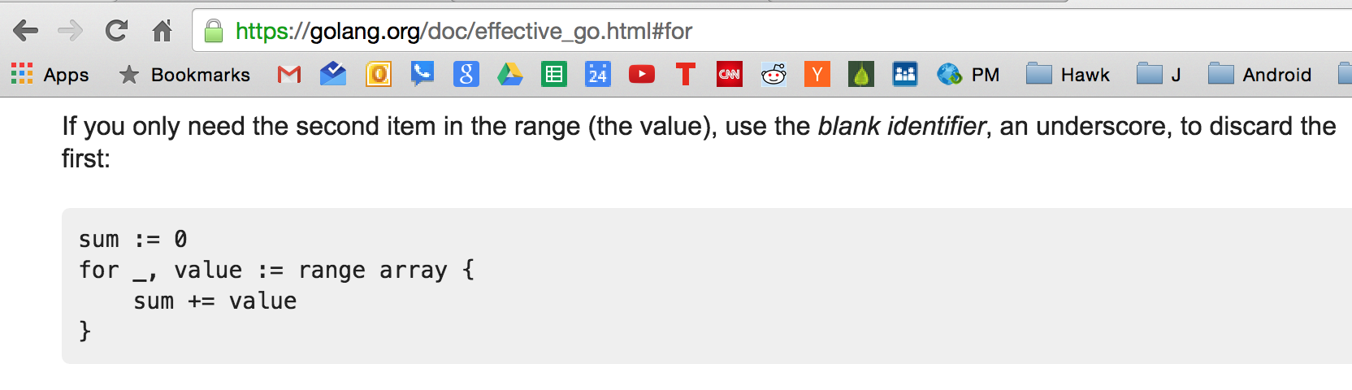

Slide 13
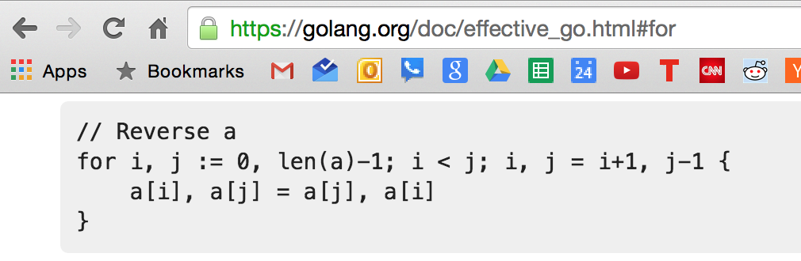
What’s going on here?
(see the next slide for help)

Slide 14
init
condition
post

Slide 15
init
condition
post
multiple assignment
multiple assignment

Slide 16
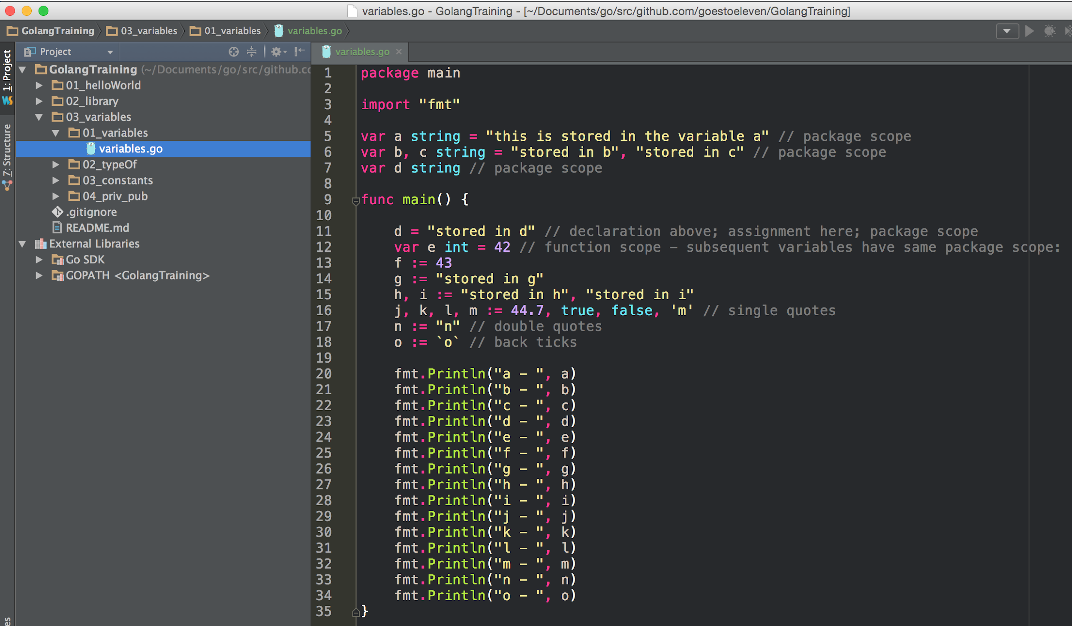
remember this?
multiple assignment

Slide 17
exercise
write a program
that loops from 1 - 1,000
printing even numbers

Slide 18
switch statements

Slide 19
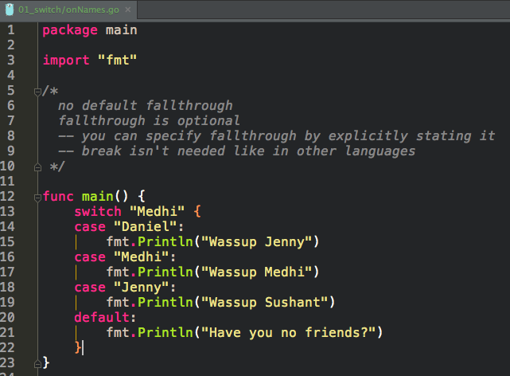

Slide 20
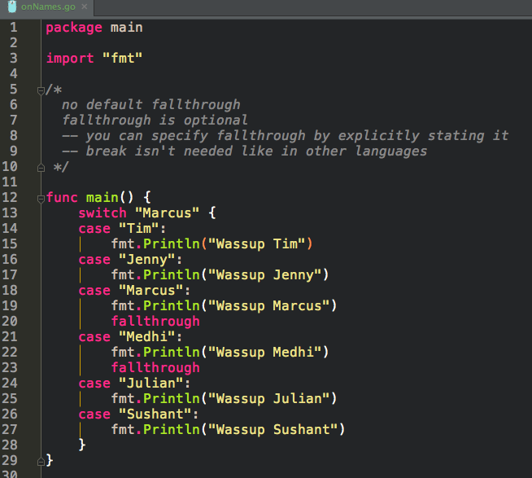

Slide 21
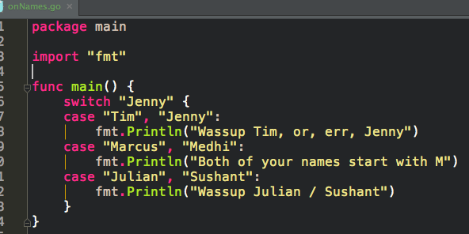
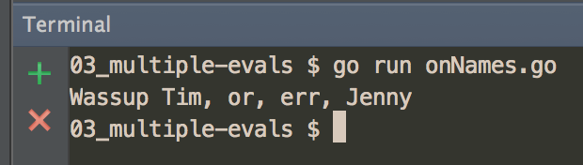
multiple evals

Slide 22
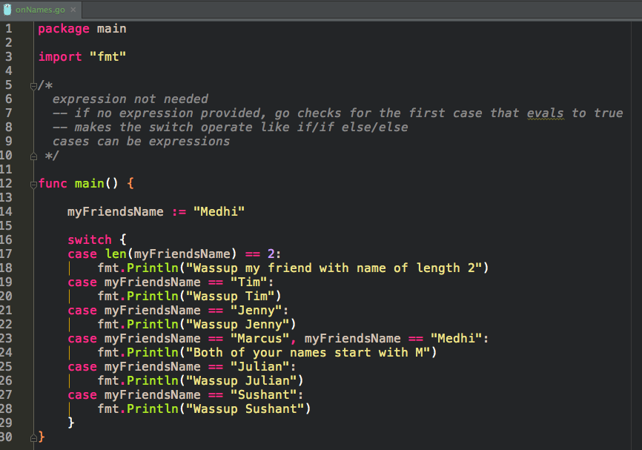
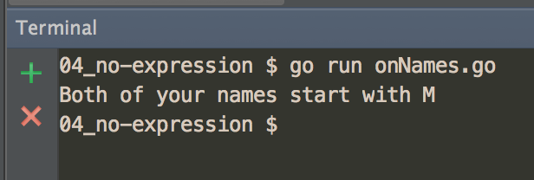
cases can be expressions

Slide 23
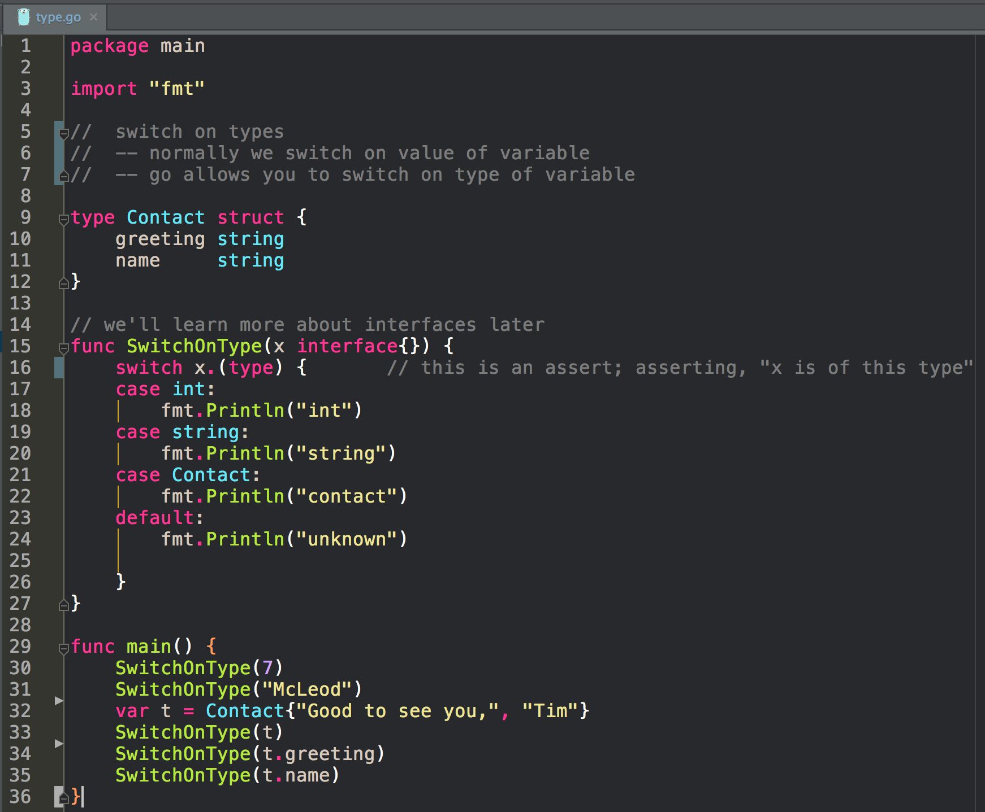
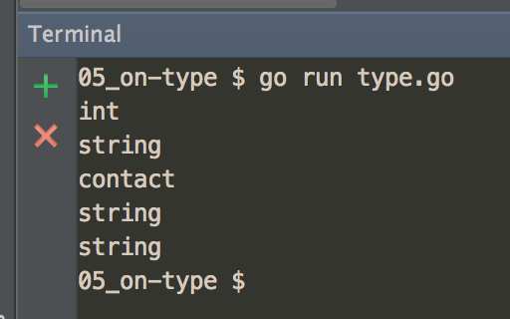

Slide 24
conditional
if statement

Slide 25
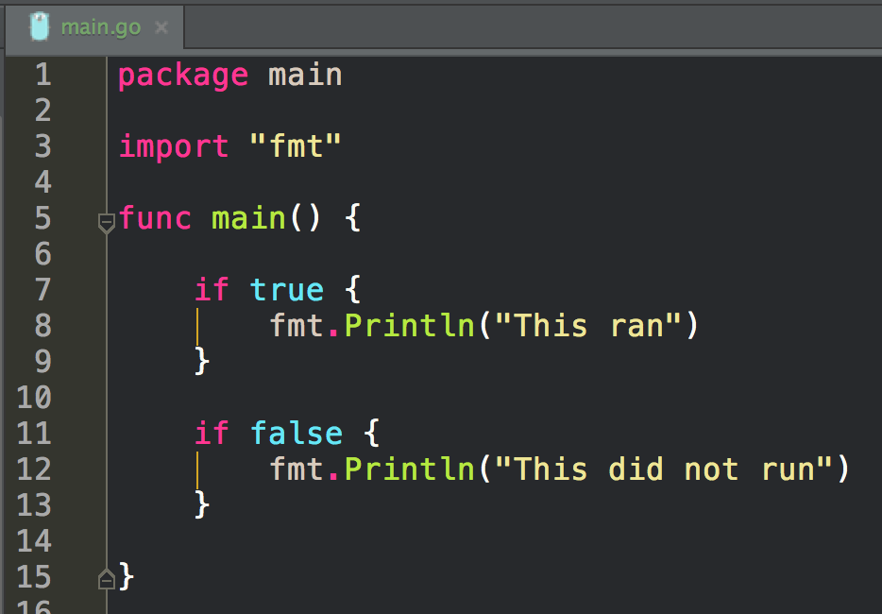
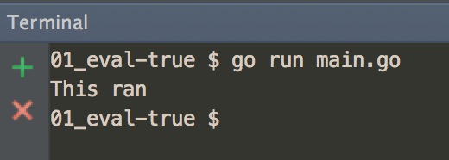

Slide 26
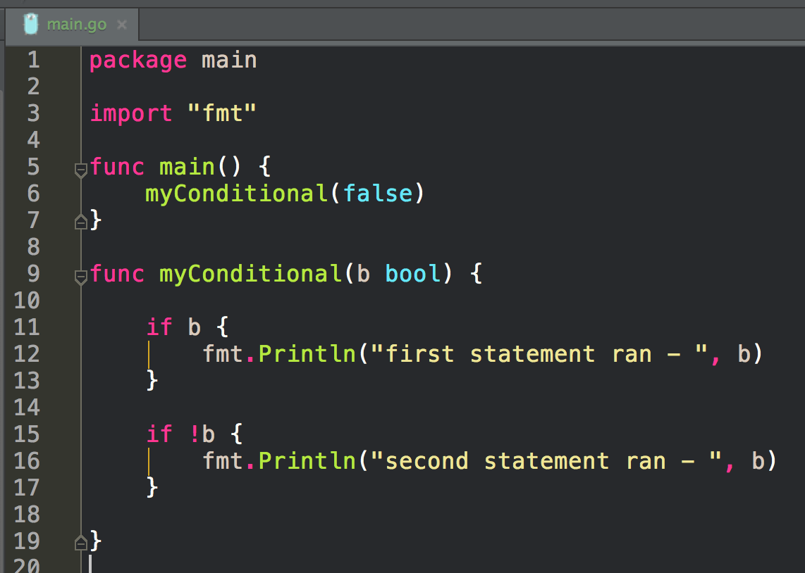
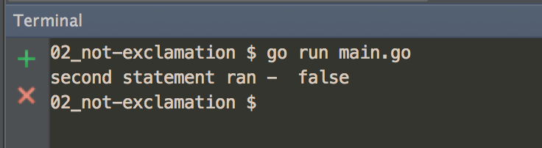

Slide 27
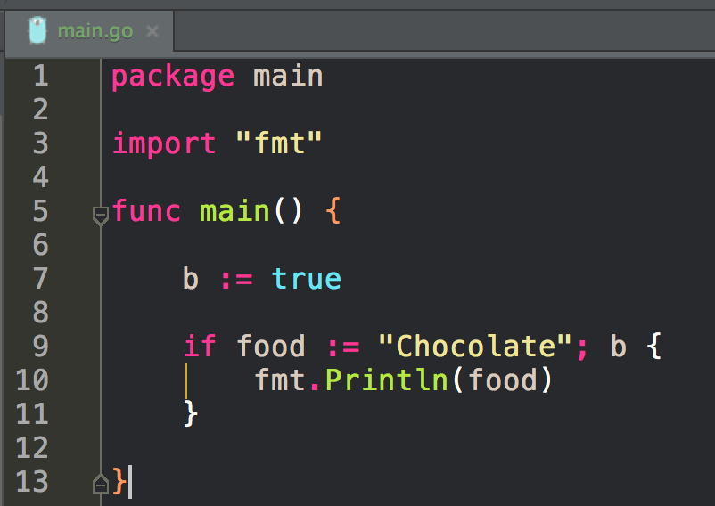
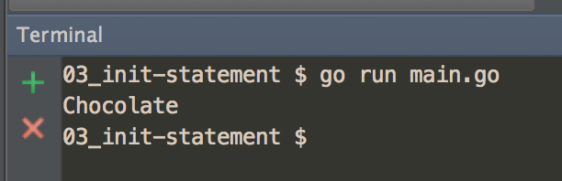

Slide 28
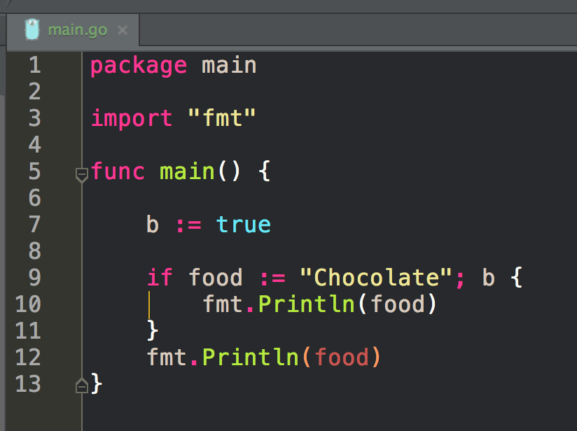

Slide 29
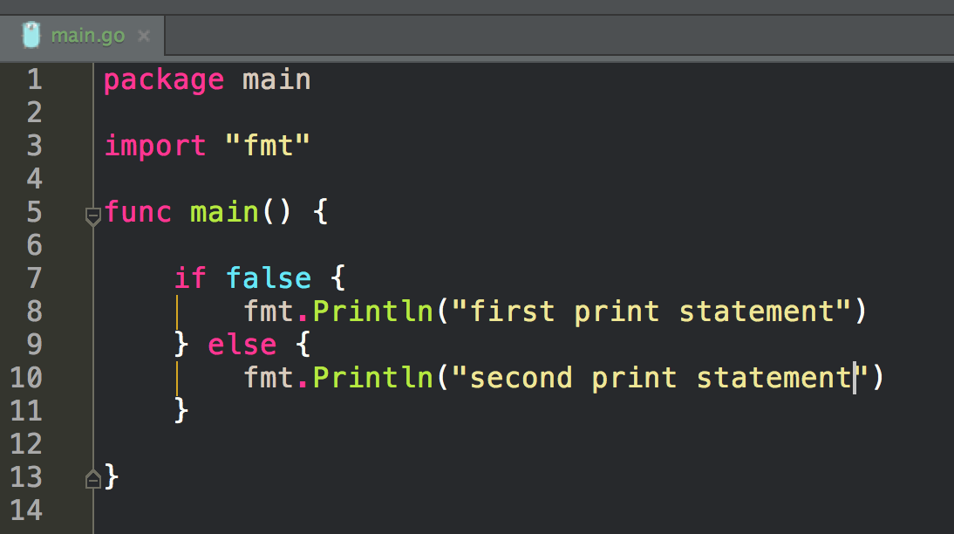
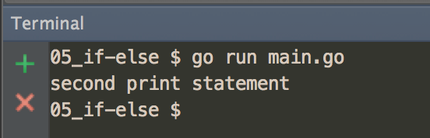

Slide 30
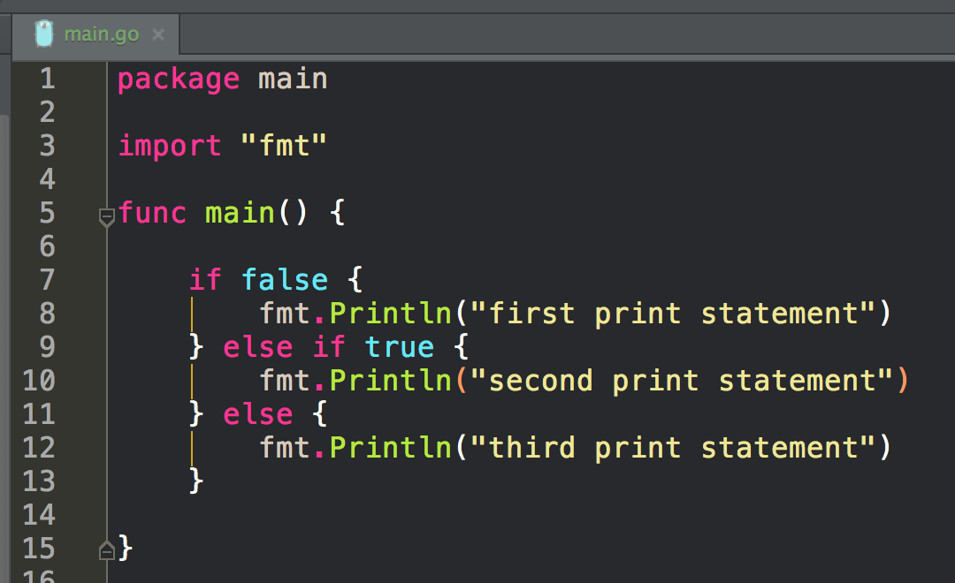
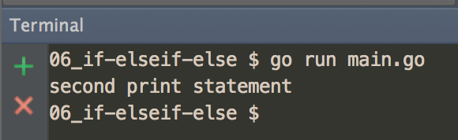

Slide 31
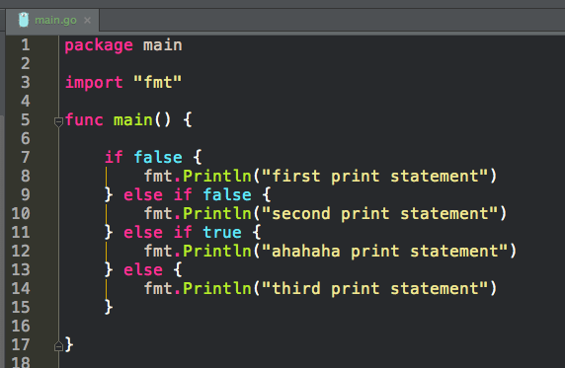

Slide 32
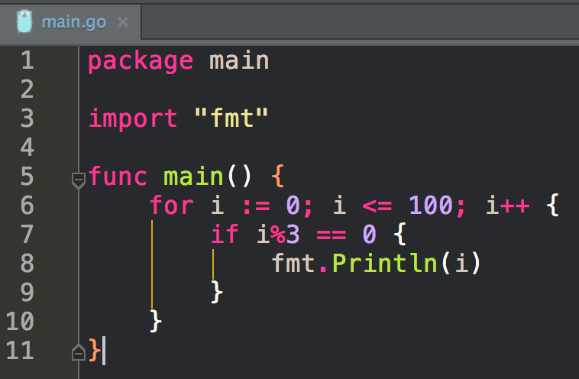
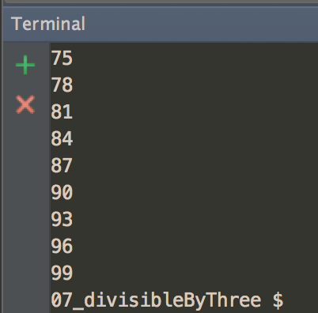

Slide 33
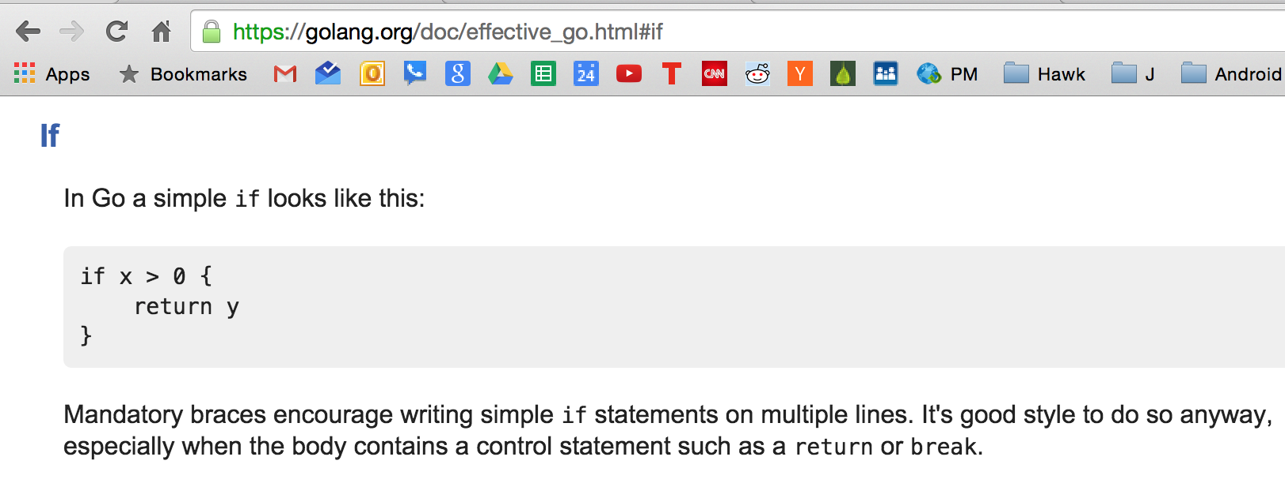

Slide 34
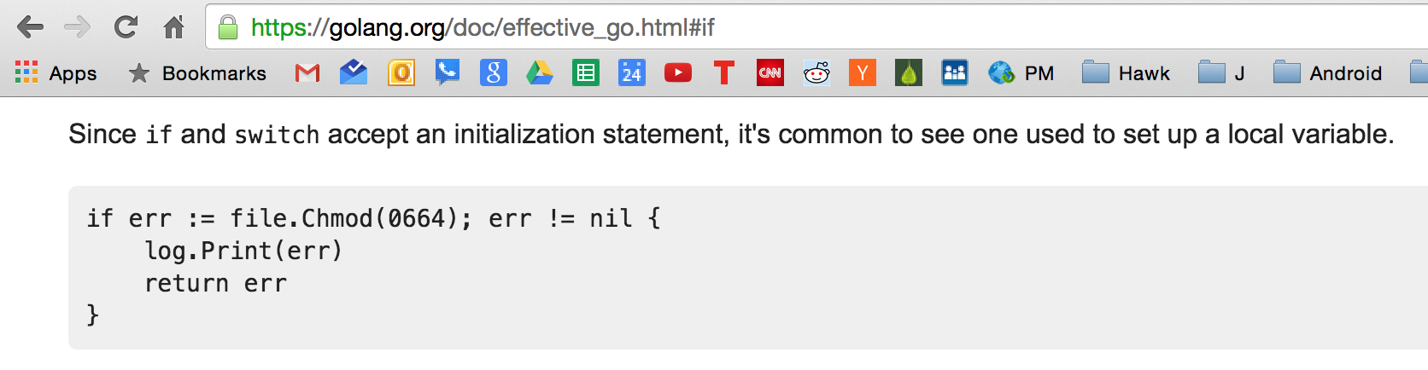

Slide 35
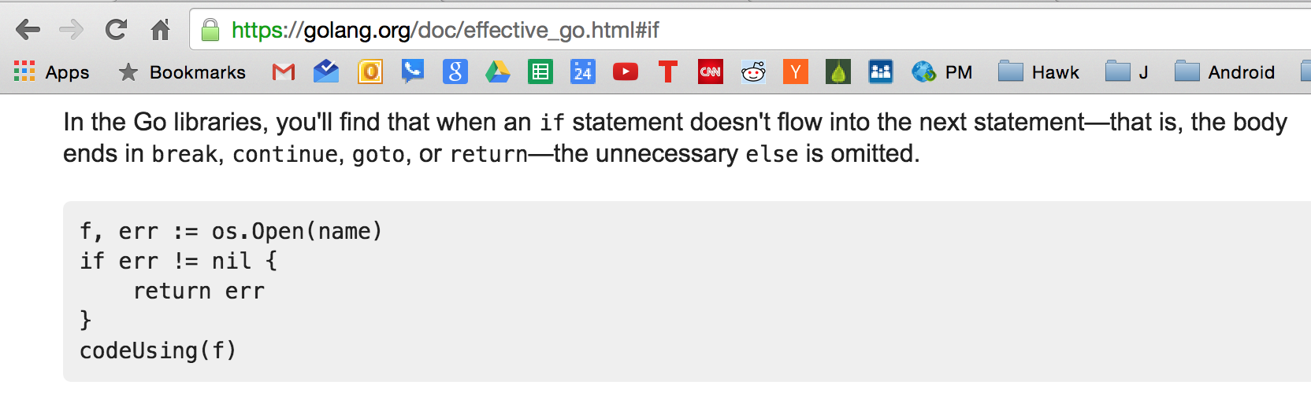

Slide 36
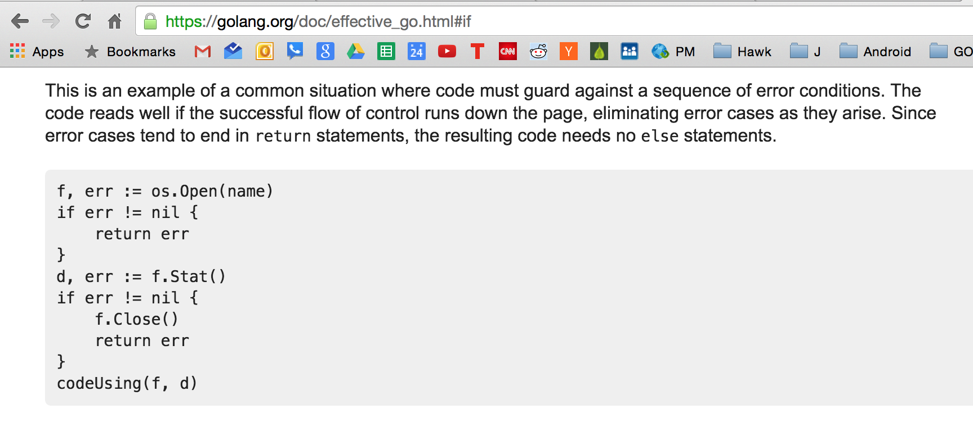

Slide 37
Can we assign to err twice?

Slide 38
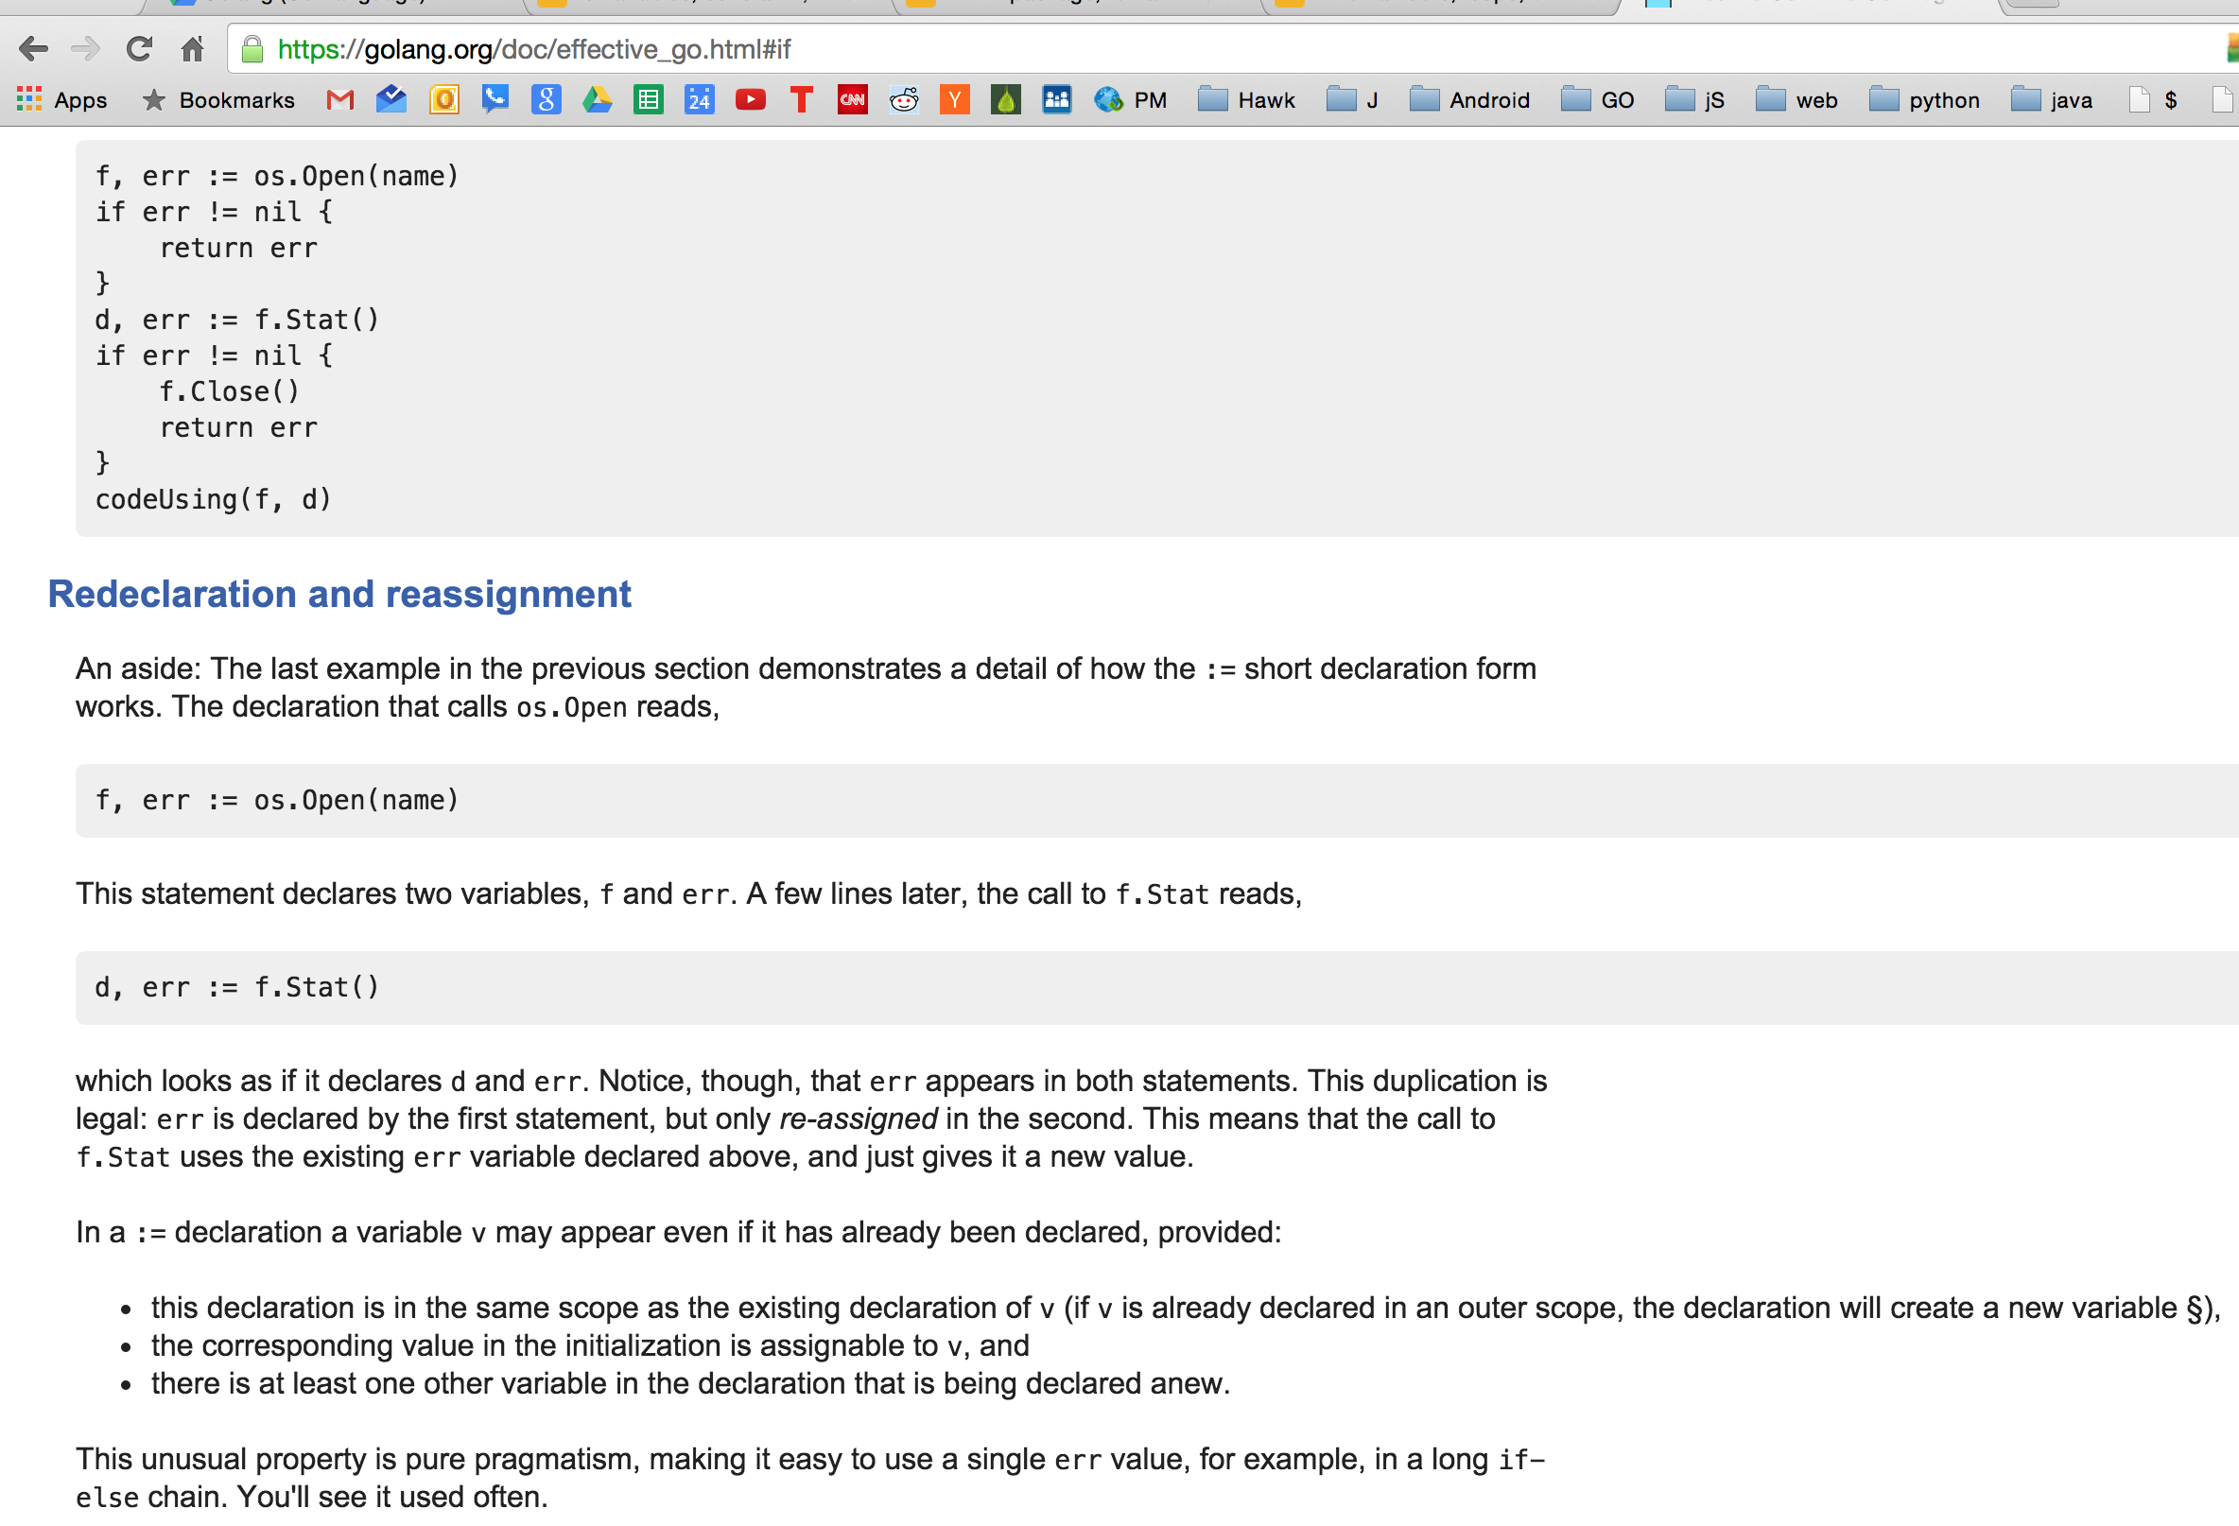
Can we assign to err twice?

Slide 39
exercise
Write a program that prints the numbers from 1 to 100. But for multiples of three print "Fizz" instead of the number and for the multiples of five print "Buzz". For numbers which are multiples of both three and five print "FizzBuzz".

Slide 40
exercise
If we list all the natural numbers below 10 that are multiples of 3 or 5, we get 3, 5, 6 and 9. The sum of these multiples is 23. Find the sum of all the multiples of 3 or 5 below 1000.

Slide 41
Review
switch
no default fallthrough
no “break” needed
“fallthrough” can be added
if
if x > 0 {
return y
}
if err := file.Chmod(0664); err != nil {
log.Print(err)
return err
}
remainder
%
loops
for init; condition; post { }
for condition { }
for { }
for key, value := range oldMap {
newMap[key] = value
}
for key := range m {
if key.expired() {
delete(m, key)
}
}
sum := 0
for _, value := range array {
sum += value
}
for i, j := 0, len(a)-1; i < j; i, j = i+1, j-1 {
a[i], a[j] = a[j], a[i]
}

Slide 42
Review Questions

Slide 43
remainder
We use % to find a remainder in go. Is % an operator or an operand?

Slide 44
loop
Write a program that uses all three of these loops:
For the last “for” make sure it includes a “break”.
Take a screenshot of your code and the results to submit for credit.
www.gobyexample.com is helpful

Slide 45
loop - range
Provide the syntax for looping over a map using range.

